Slide 1

Mid-Western University
Central Campus of Science and Technology
NETWORK DESIGN AND SIMULATION OF SMART CITY WITH IoT
Presented By:
1. Dharmendra Thapa
2. Abi Rawat
3. Suraj Shahi

Slide 2
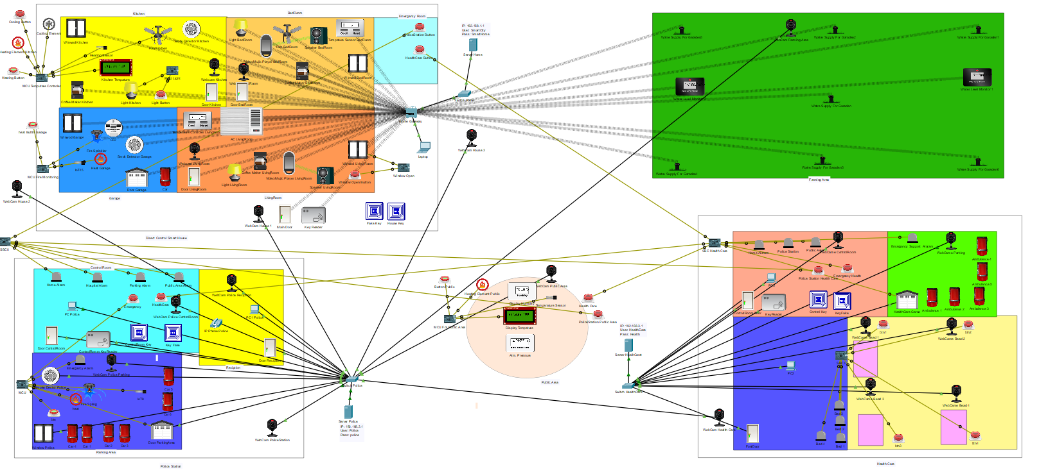
Smart City

Slide 3
ABSTRACT
Today’s world is technology world. Where technology is the key of their life style. Humans are rapidly changed technology as well as increase ideas about new technology, but humans lifestyle and daily worked are also changed by the technology. Technologies are used in every sector of the world and which helps to reduce time, effort, cost and increase accuracy.
This project include the concept of smart city in-order to make our smart life style which reduce our time, effort, cost and increase work effective and also increase accuracy of work. Here we simulate and design the network of smart cities using concept of real smart cites. Here we include different-different component which is the part of smart city (like: Smart Home, Smart Public Area, E-Police, E-Health Care/Hospital, Smart Farming).

Slide 4
INTRODUCTION
This project contains different types of IoT (Internet of Thing) devices. Each device are connected through the wireless or wired network. This project will cover the concept of smart houses, smart parking system, smart police and health care. This project will also cover the data of the surrounding environment using different sensors (like temperature, and humidity). A smart city wants to respond to the challenges of our time, such as those regarding sustainability and quality of life
Smart city is built with the incorporation of information and communications technology, which allows management of urban infrastructure effectively. Sensor network, Internet of Things (IoT), digital infrastructure, bulky data generated from biological websites, social networking, GPS data sets are important sources of the database to build the smart city with effective management governance, business, health, transport, resources and energy.

Slide 5
Block Diagram of Network Designing
PublicServer
PC/Laptop/Mobile
IoT Device 3
Health Server
Switch/Hub
PC/Laptop/Mobile
IoT Device 3
IoT Device 2
IoT Device 1
Switch/Hub
Police Server
IoT Device 2
IoT Device 1
IoT Device 3
Switch/Hub
Farming Server
PC/Laptop/Mobile
IoT Device 2
IoT Device 1
IoT Device 3
Home Server
Switch/Hub
PC/Laptop/Mobile
Home Appliance4
IoT Device 2
IoT Device 1
Switch/Hub
Home gateway
Home Appliance3
Home Appliance2
Home Appliance1

Slide 6
PROBLEM OF STATEMENT
Managing large city and complex home appliances are growing challenges of present time. Which leads to the following questions and this project work will provides the solution to these problems:
How effectively the normal environment and relevant technology are used to provide a SMART solution for different abled individuals with assistive technology?
How effectively the standards and relevant techniques are used to find a relevant requirement in supermarket process with clustering?
How effectively is the environment used to get best package and predict preference with data science?

Slide 7
OBJECTIVE
Main objectives of this project work are:
To design and simulate the networking of a Smart House and Smart City by connecting different Smart House and Internet of Things (IoT). (i.e, how electronic device are connecting with each other through the network or internet).
To elaborate the Automation of home devices, reduce Time and increase efficiency thus establish smart lifestyle.

Slide 8
SCOPE AND LIMITATION
Scope
The scope of Smart City is improving our quality of life.
Improving environmental quality in the urban space/area.
The transports system are part of smart mobility which reduce our time spent.
Limitation
The it the conceptual model of real system/city
This project uses virtual devices and connection.

Slide 9
LITERATURE REVIEW
A smart city is one that use ICT such that city services and monitoring are more aware, interactive and efficient. According to the Literature Survey the history of relevant Cities could be identified. Some cities had developed general cities into Smart cities by using their various technology.
Taiwan Smart City: According to the program introduced here, Chunghwa Telecom will assist Taiwan’s Government in achieving a smart city within three years. The programs and sub-programs are lunched for smart city are: -
a. Convenient City
b. Happy City
c. Friendly City
New York City: The “New York City” is developing a number of smart city initiatives. An example is the series of city services kiosks in the LinkNYC network. These provide services including free WIFI, phone calls, devices charging stations, local wayfinding and more, funded by advertising that plays on the kiosk’s screens.
Singapore Smart Nation
The “Smart Nation Singapore” , a city-state has embarked on transforming towards a Smart Nation, and endeavors to harness the power of network, data and info-comm technologies to improve living, create economic opportunities and built closer communities.

Slide 10
METHODOLOGY
We simulate and networking design of smart house and smart city through the Packet Tracer. Home device, networking devices and other corporate devices are used to communicate with each other in packet tracer. The communication is established by connecting these devices with all devices through internet which means Internet of Thing (IoT).
In this project network for Smart House, E-police, Smart Public Area, Smart Farming and Smart Health Care are designed as mentioned above with appropriate expiation.
There are following parts of methodology. They are mention below:
Algorithm
Flow Chart
Configuration
Programming

Slide 11
Algorithm
Step 1: Start the Packet Tracer.
Step 2: Create a new “.pkt” file using packet tracer.
Step 3: Add the required components to the work space as packet tracer simulator.
Step 4: Connect all devices in work space Using cables or wireless router.
Step 5 : Add Home Gateway or switch to the Network.
Step 6: Configure the device and setup internet service provider router/Server.
Step 7 : Connect smart Devices to the Wireless Network and remote server.
Step 8 : Add End User Device to the Network.
Step 9: Stop

Slide 12
Flow Chart
Start
Add the require component to the workspace
Configure Router
No
Check Connection
Yes
Connect IoT Devices
Add to Server
Add End User Devices
Stop

Slide 13
Configuration
In building Smart City network can be implemented through the simulation concept designed on Cisco Packet Tracer. Some of the tools needed to build a smart city network are IoT devices. The home gateways that function as transmission media paths and provide automatic addressing to multiple devices connected via wireless networks, Pc/Laptop/Smartphone that serve as interfaces in controlling and monitoring electronic devices, and some devices to be controlled based on conditions set on server.
There is 2 types of configuration needed to simulate the smart city and it’s components. They are mentions below:
Server Configuration
Devices Configuration

Slide 14
Server Configuration
In Server Configuration we can use both command line and GUI method. But in this project we use command line method. The necessary command for configuration and assign IP address for different components of smart city are mention below:
Command for assigning IP address for main server for smart home:
Switch> en
Switch# config terminal
Switch(config)# int GigabitEthernet0/1
Switch(config-if)# ip address 192.168.1.1 255.255.255.0
Switch(config-if)# no shutdown
Command for assigning IP address for main server for E-Police:
Switch> en
Switch# config terminal
Switch(config)# int GigabitEthernet0/1
Switch(config-if)# ip address 192.168.2.1 255.255.255.0
Switch(config-if)# no shutdown
Command for assigning IP address for main server for E-Health Care:
Switch> en
Switch# config terminal
Switch(config)# int GigabitEthernet0/1
Switch(config-if)# ip address 192.168.3.1 255.255.255.0
Switch(config-if)# no shutdown

Slide 15
Devices Configuration
Steps to configure any devices for wireless medium:
Select device and double tap it and open window of device
Click on ‘Advance’ tap
Click on ‘I/O config’
Select “PT-IOT-NM-1W” on Network Adapter
Click on ‘Config’ tap
Select ‘wireless’ on Interface
If security is used then set ‘SSID’ and ‘Password’
Select ‘DHCP’ on IP Configuration
Select ‘Setting’ option and set ‘Server Address’, ‘User Name’ and ‘Password’ of connected server on ‘IoT Server’ section
Click connect button.
Steps to configure any devices for wired medium:
Connect device to the server through switch/router
Select device and double tap it and open window of device
Click on ‘Config’ tap
Select ‘FathEthernet0’ on Interface
Select ‘DHCP’ on IP Configuration or set ‘IP Address’ and ‘Subnet Mask’ in static option
Select ‘Setting’ option and set ‘Server Address’, ‘User Name’ and ‘Password’ of connected server on ‘IoT Server’ section
Click connect button. .

Slide 16
Programming
We are using JavaScript programming language with its in-built IoT package. Here we are writing JavaScript program into the MCU or SBC which is connected to the other devices with to control these devices. TO write a program we use following steps:
Select and place the MCU or SBC to the workplace in packet tracer.
Connect all necessary devices to the MCU or SBC.
Double click on MCU or SBC.
Select programming tab
Select new and choose your prefer environment and programming language.
Here we select JavaScript and clicks create.
Open file show there and start writing program.

Slide 17
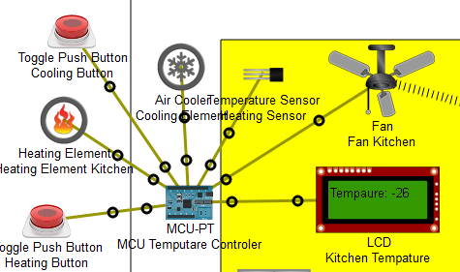
Programming for controlling Fan
In this section we are using MCU to write a program to control fan on temperature condition. Here we use Heating element to increase temperature and Cooling element to decrease the temperature through the respective button. Here temperature sensor and LCD are also used in order to get temperature from environment and display it into the LCD.

Slide 18
The written code to control fan in MCU is given below
var ts=A0;
var ac=1;
var he=2;
var lcd=3;
var b=4;
var fan=5;
var b1=0;
function setup()
{
pinMode(ac, OUTPUT);
pinMode(he, OUTPUT);
}
function loop()
{
var temperatura=Math.round((((analogRead(A0) - 0) * (100 - (-100)))/(1023 - 0)) + -100);
customWrite(lcd,"Tempaure: "+temperatura +" C");
Serial.println(temperatura)
//for heating
if(digitalRead(b)== HIGH)
digitalWrite(he, HIGH);
else
digitalWrite(he, LOW);
//for colling
if(digitalRead(b1)== HIGH)
digitalWrite(ac, HIGH);
else
digitalWrite(ac, LOW);
//for fan
if(temperatura>=2)
customWrite(fan, 1);
else
customWrite(fan,0);

Slide 19
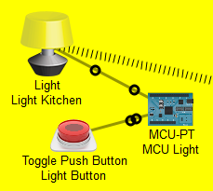
Programming for controlling room light
To control room light we are using MCU, light and button. Where button is use to turn on/off the room light and MCU is use to written a code for that. Here we are connected the light and button to the MCU.

Slide 20
Written code to controlling room light is given below:
var b=0;
var la=1;
function setup()
{
pinMode(b, INPUT);
pinMode(la, OUTPUT);
}
function loop()
{
var value = digitalRead(b);
if(value==HIGH)
customWrite(la, 2);
else
customWrite(la, 0);
}

Slide 21
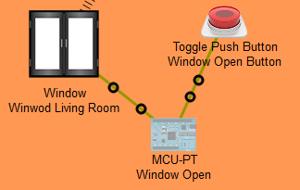
Programming for controlling room Window
To control room window we are using MCU, room window and button. Where button is use to turn open/close the room window and MCU is use to written a code for that. Here we are connected the window and button to the MCU.

Slide 22
Written code to control the room window is
var b=0;
var w=1;
function setup()
{
pinMode(b, INPUT);
pinMode(w, OUTPUT);
}
function loop()
{
var value = digitalRead(b);
if(value==HIGH)
customWrite(w, HIGH);
else
customWrite(w, LOW);
}

Slide 23
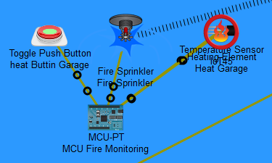
Programming for controlling Fire Sprinkler
To monitor the fire in any room we use fire sprinkler. Here we connected Fire Sprinkler, Heating Element, Button and MCU to monitor the fire. When fire is detected then the fire sprinkler is on and start sprays water otherwise it is in off state.

Slide 24
Written code to controlling fire sprinkler is
var h=0;
var b=1;
var fs=2;
function setup()
{
pinMode(b, INPUT);
pinMode(h, OUTPUT);
pinMode(fs, OUTPUT);
}
function loop()
{
var value=digitalRead(b);
if(value==HIGH)
{
digitalWrite(h, HIGH);
customWrite(fs, 1);
}
else
{
digitalWrite(h, LOW);
customWrite(fs,0);
}
}

Slide 25
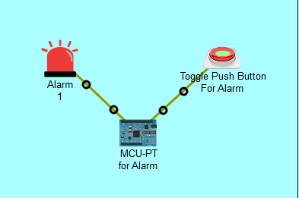
Programming for controlling Alarm
To control Alarm we are using MCU, Alarm and button. Where button is use to turn on/off the Alarm and MCU is use to written a code for that. Here we are connected the window and button to the MCU.

Slide 26
Smart Home
We use IoT devices to make our traditional home into smart home. IoT devices are connected through the wired or wireless and communicated each other with the help of server. All device is automatically start or stop by specific condition/rule which are added in the Home Gateway devices. The Home Gateway act as a server and control all devices connected to the smart house/city. The all devices are monitor through the Mobile or PC or Laptop at home gateway server.
Home Server
PC/Laptop/Mobile
Farming Area Device
Home Appliance4
Switch/Hub
Home gateway
Health Care Device
Home Appliance3
Police Station Device
Home Appliance1
Home Appliance2
Block Diagram of Smart Home

Slide 27
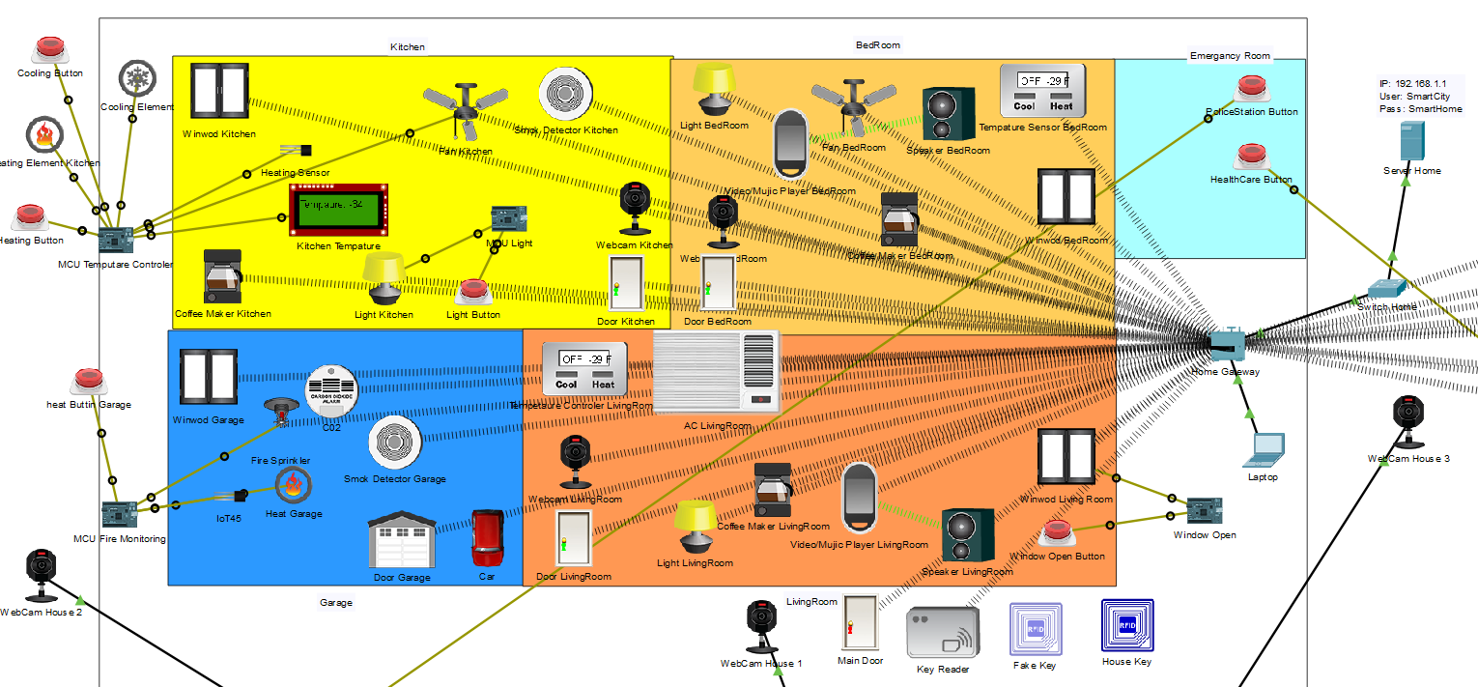
Network Design of Smart Home

Slide 28
E-Police
The concept of e-police is easy access of police in needed condition. Here we use button and alarm to contact polices in needed condition from everywhere in every-places. Polices are easily monitor the current situation of cities as well as crime recode of the cities. Here all the complain about any crime are store into the server and we can post our complain through online as well as button. The concept of e-police is providing the police services fast as possible. Here we use button at home and alarm at police station. These services will used at emergency case when people will unable to call and visit police station.
Police Server
PC/Laptop/Mobile
Home
IoT Device 3
Switch/Hub
Public Area
IoT Device 2
IoT Device 1
HealthCare
Block Diagram of E-Police

Slide 29
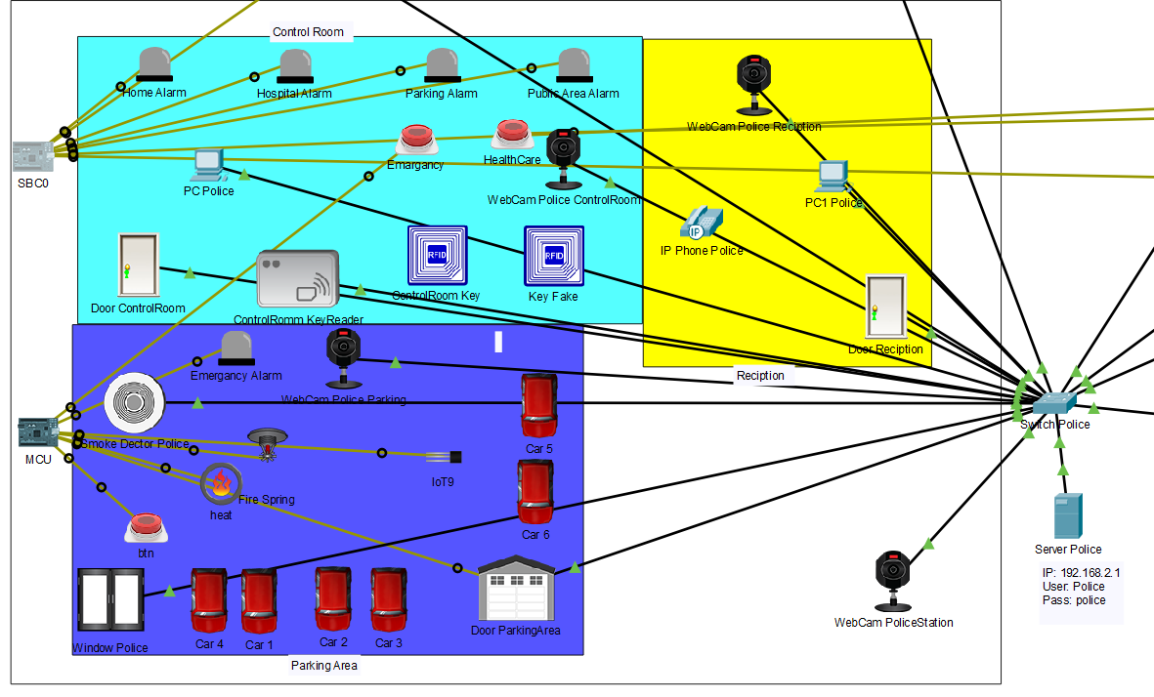
Network Design of E-Police

Slide 30
E-Health care
This concept same as e-police but here only one different is the alarm is use in the health center and the email is send to the ambulance driver. This also use in emergency case. The concept of e-health care is to easily accessible the services of health care or hospital. Where we use webcam to monitor the patient in our hospital, we can store the recode of our patient and their diseases. The doctors can monitor the health condition of their respective patient due the easily accessible their report. Due to the collection of all data about diseases and their symptoms we can maintain the health condition of our patient as well as health policy for the people.
Health Server
PC/Laptop/Mobile
Home
IoT Device 3
Switch/Hub
Public Area
IoT Device 2
IoT Device 1
Police Station
Block Diagram of Health Care

Slide 31
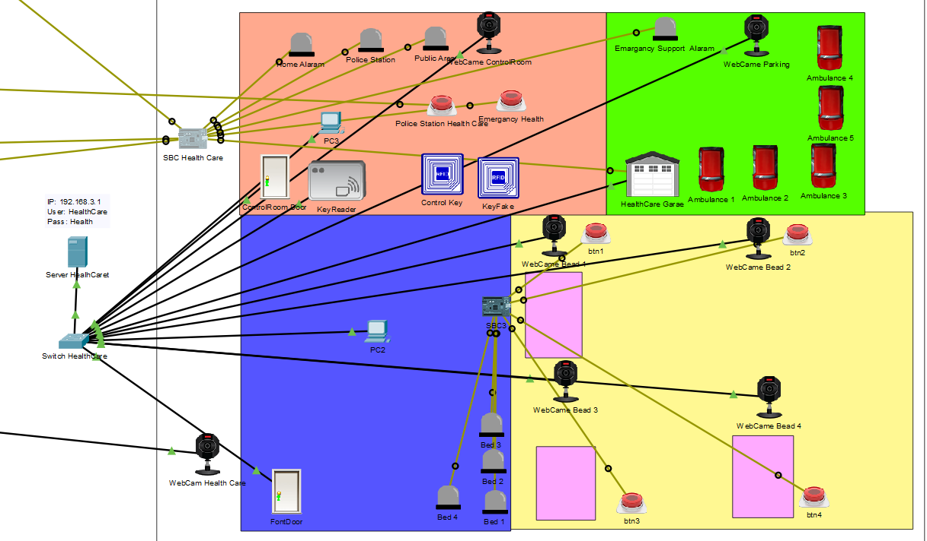
Network Design of Health Care

Slide 32
Smart Farming
This is the concept to improve the farming styles which helps farmer. Here we use water level detector sensor which detect the water level of plant and spring to provide the water which depends on the water level.
Farm Server
PC/Laptop/Mobile
IoT Device 3
Switch/Hub
Home
IoT Device 2
IoT Device 1
Block Diagram of Smart Farming

Slide 33
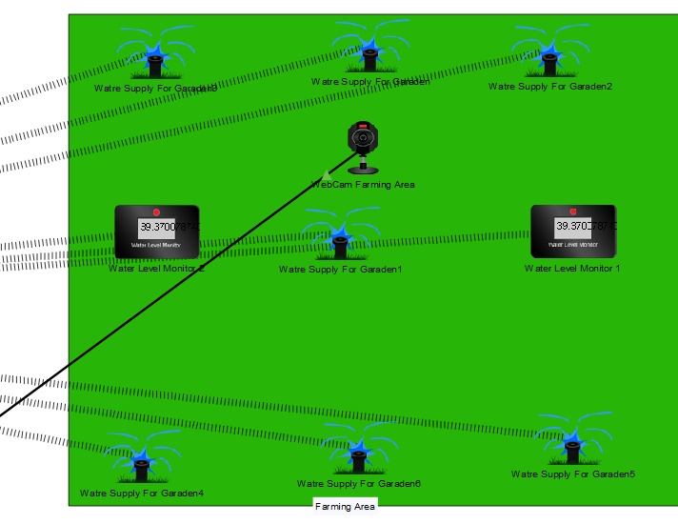
Network Design of Smart Farming

Slide 34
Smart Public Area
This is the place where we easily get all the information for the people All the information about government, environment, polices, health care, education, economic, parking, advataiegment. This place for providing any kind of information for the people.
Public Server
PC/Laptop/Mobile
IoT Device 3
Switch/Hub
Home
IoT Device 2
IoT Device 1
Block Diagram of Smart Public Area

Slide 35
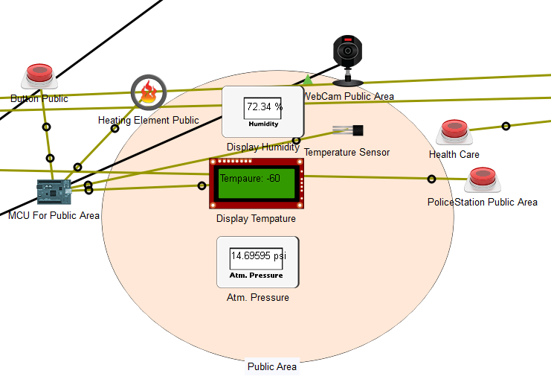
Network Design of Smart Public Area

Slide 36
CONCLUSION
The objectives of this project are, to design and simulate the networking design of a Smart House and Smart City by connecting different Smart House and Internet of Things (IoT) devices.
The outcome of this project will be core concept of working mechanism of the smart city. This project will be used for automated the IoT devices for smart lifestyle. This project will be able to reduce time and increase efficiency using automated devices.

Slide 37
RECOMMENDATION AND FUTURE WORK
This project can’t demonstrate other feature and component so we place this in recommendation and future work. There are following topic and concepts are given below:
Smart Government:
The concept of Smart government is to track the recodes about local government. Which include all the information about local level government, all the information about economical status of our local government. Here we can know about the current development projects as well as all the information about their estimate cost, information about contractor of respective projects. This also provide all information about previous development projects with their total cost and completion report of the projects. This also provide the current population of the city which is dynamically changed which is connected to the local level office and as well as all the hospital, medical of their cities to get information about birth rate and death rate of city peoples.
Smart Economic:
This is the concept of provide information about economical status our city. Here we store all the information related to the economic of our city. Which store all the information about collected tax in every days, share, investments, profit, loss and so on. Which provide economical status of our city. Which also include share market, government investments, profit of any organization, loss of any organization, government economic, cost of government projects, donations for local government .

Slide 38
REFRENCE
Amsterdam. (2020, February 4). Retrieved from Wikipedia: https://en.wikipedia.org/wiki/Smart_city#Amsterdam
Chunghwa Telecom, T. (n.d.). Planning and Implementing a Smart City in Taiwan. Taiwan: National Taichung University of Science and Technology, Taiwan.
Design IoT Based Smart Parking System using Packet Tracer. (2017, December 24). Retrieved from Youtube: https://www.youtube.com/watch?v=KP7IHZesoTk&t=139s
Important of Smart City. (2019, November 16). Retrieved from SlideShare: https://www.slideshare.net/100002576666085/importance-of-smart-city-project-and-its-policies-at-vellore-a-case-study?qid=6f04bb96-29f9-463d-85aa-15799e0e862f&v=&b=&from_search=1
New York City. (2020, January 26). Retrieved from Wikipedia: https://en.wikipedia.org/wiki/Smart_city#New_York_City
Packet Tracer. (n.d.). Retrieved from netacad: https://www.netacad.com/courses/packet-tracer
Packet Tracer IoT Tutorial video 2 Setting up a Smart Home. (2018, April 29). Retrieved from Youtube: https://www.youtube.com/watch?v=fGG8XcC8LSM
San Leandro, California. (2020, January 26). Retrieved from Wikipedia: https://en.wikipedia.org/wiki/Smart_city#San_Leandro
Singapore Smart Nation. (2020, January 26). Retrieved from Wikipeda: https://en.wikipedia.org/wiki/Smart_city#Smart_Nation_Singapore
Smart Cities. (2014, May 29). Retrieved from Centreforcities: https://www.centreforcities.org/reader/smart-cities/
Smart Home Delivery E-Shopping cart to Facilitate. (December 2017). International Journal of Computer Applications (0975 – 8887), Volume 180 - No.

Slide 39
Thank You

